Slide 1
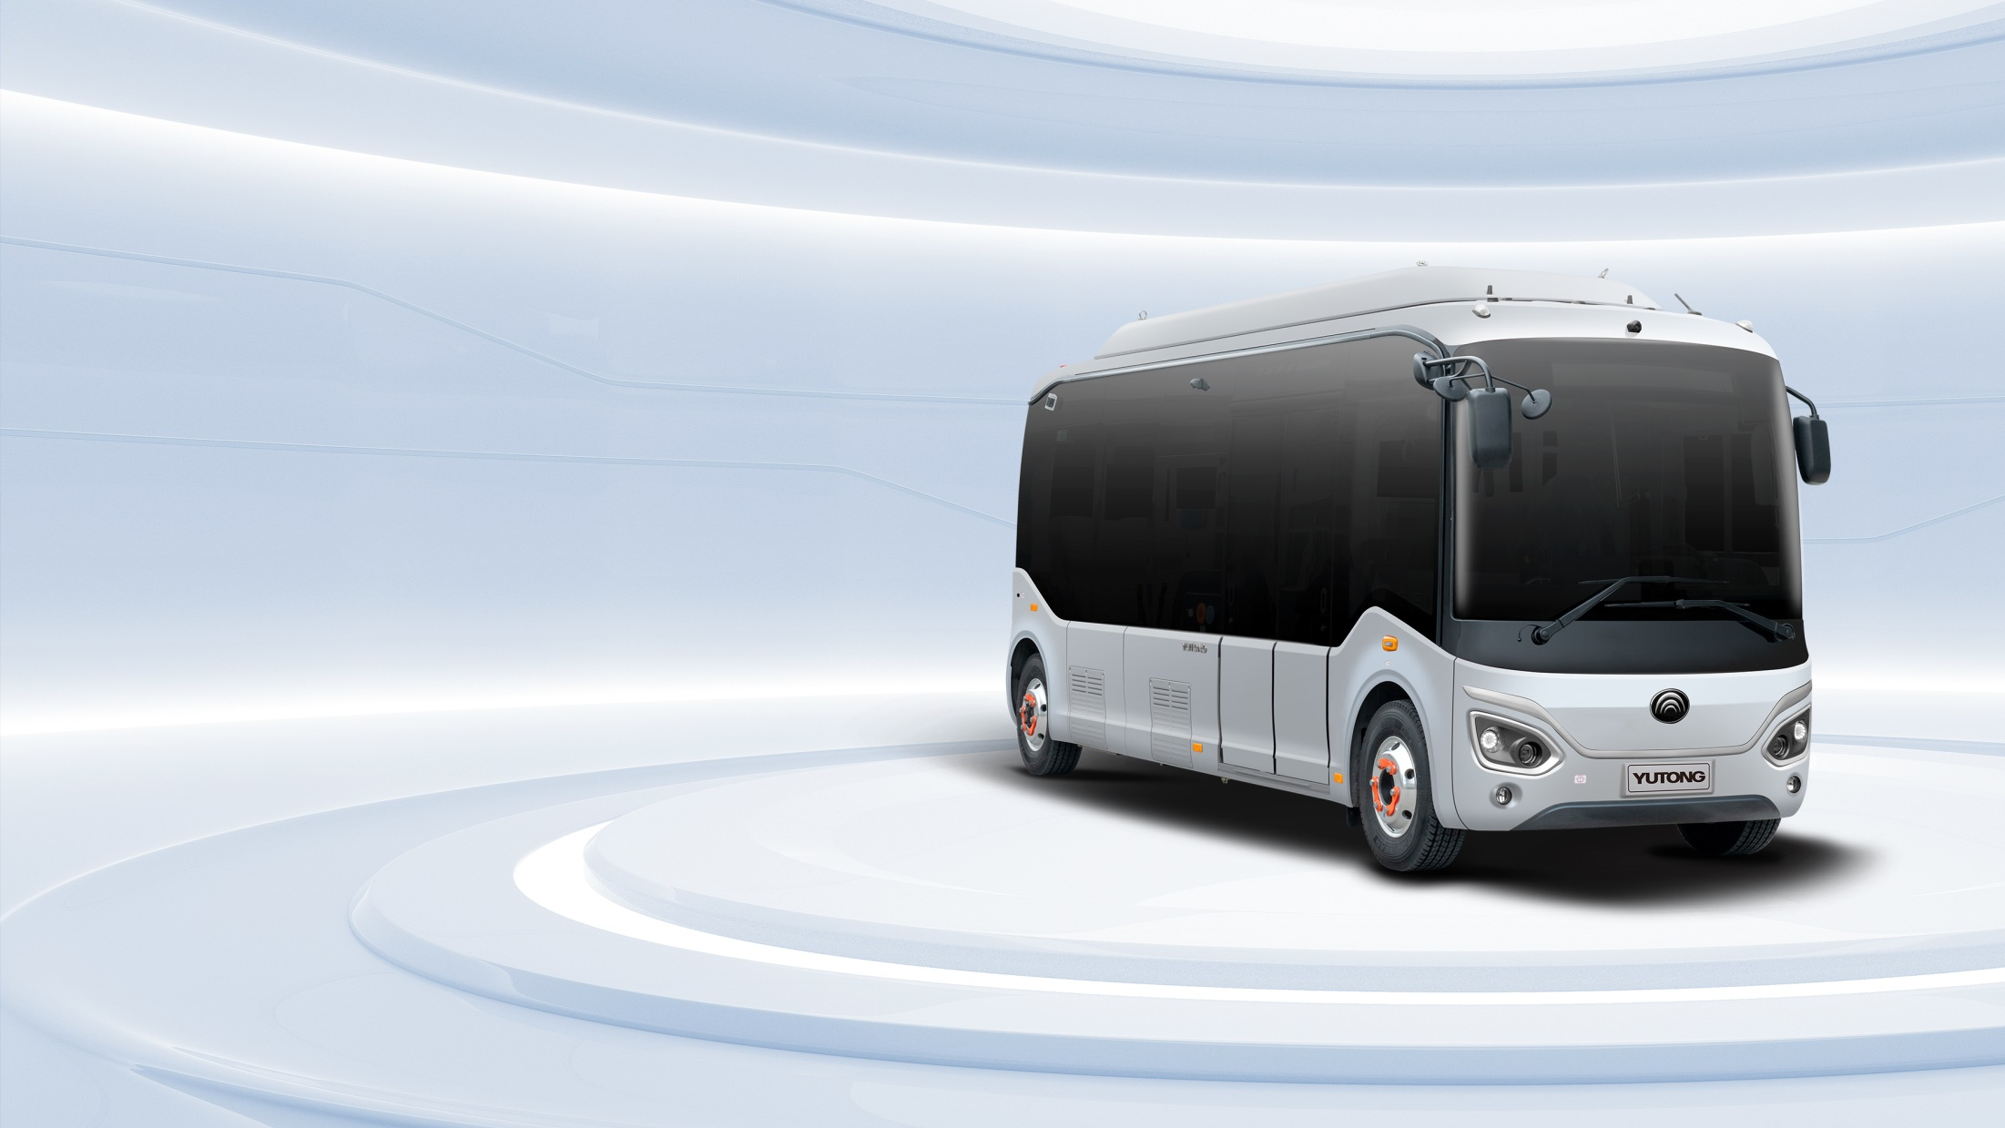

ZK6706BEVG
Battery Electric Bus

Slide 2
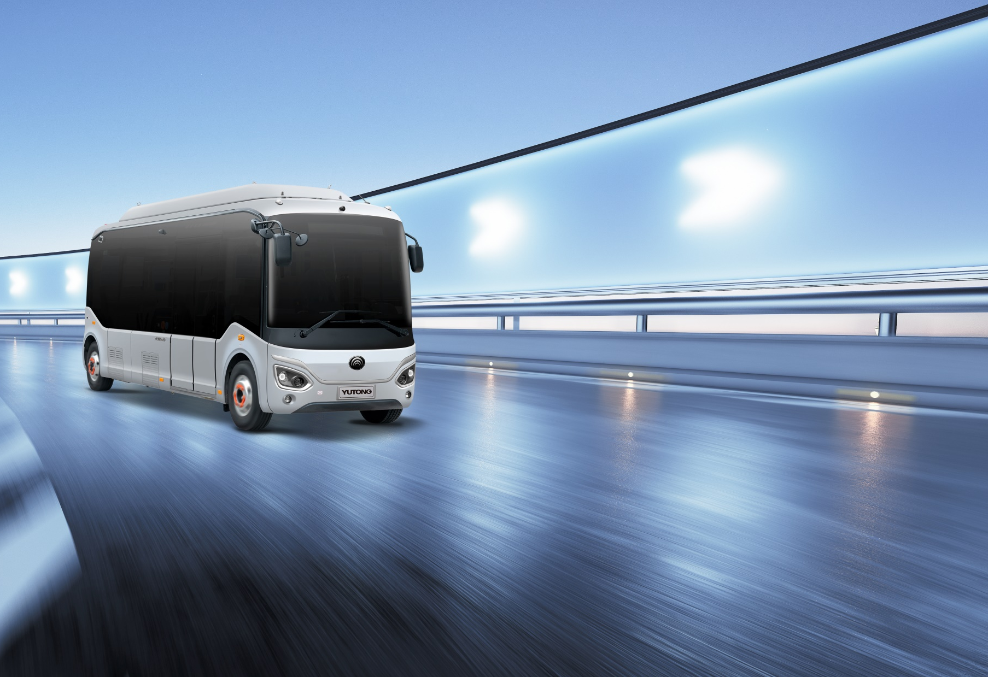

PART. 1
High Quality with Value

Slide 3
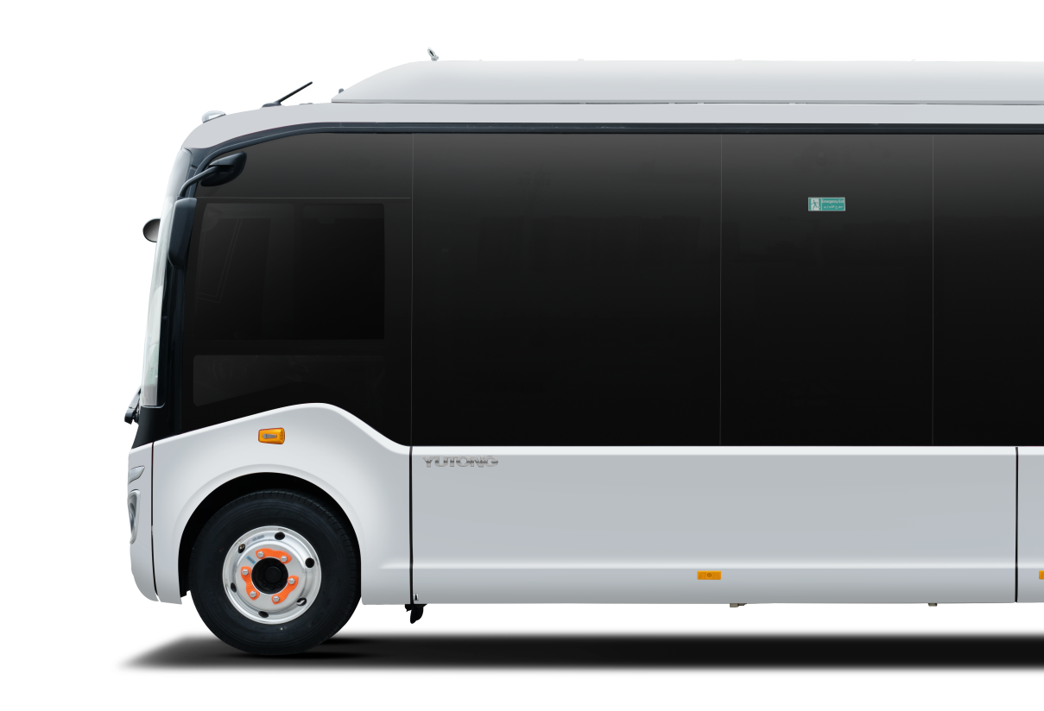
High Quality with Value
ZK6706BEVG
Standing by a “customer-centric” operation philosophy, it seeks R&D progress and innovation by building on proven experiences and relying on innovation platforms in pursuit of high-tech and green performance, as well as high quality with dedication. "Last mile" link-up for better mobility of customers.

Slide 4
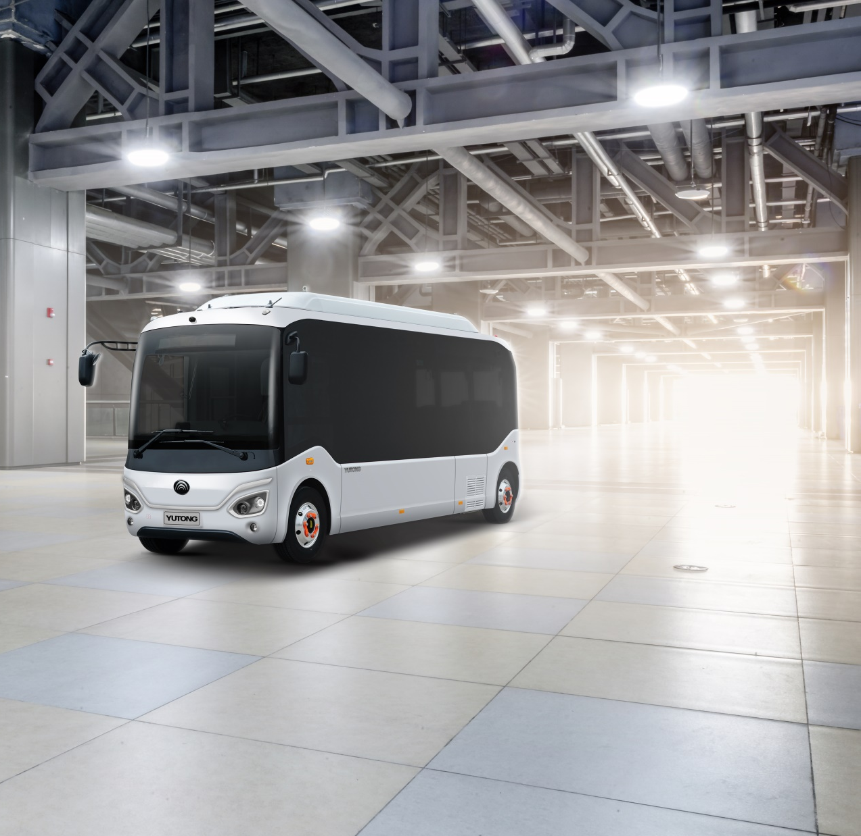
PART. 2
Appearance
Elegant and Distinctive

Slide 5
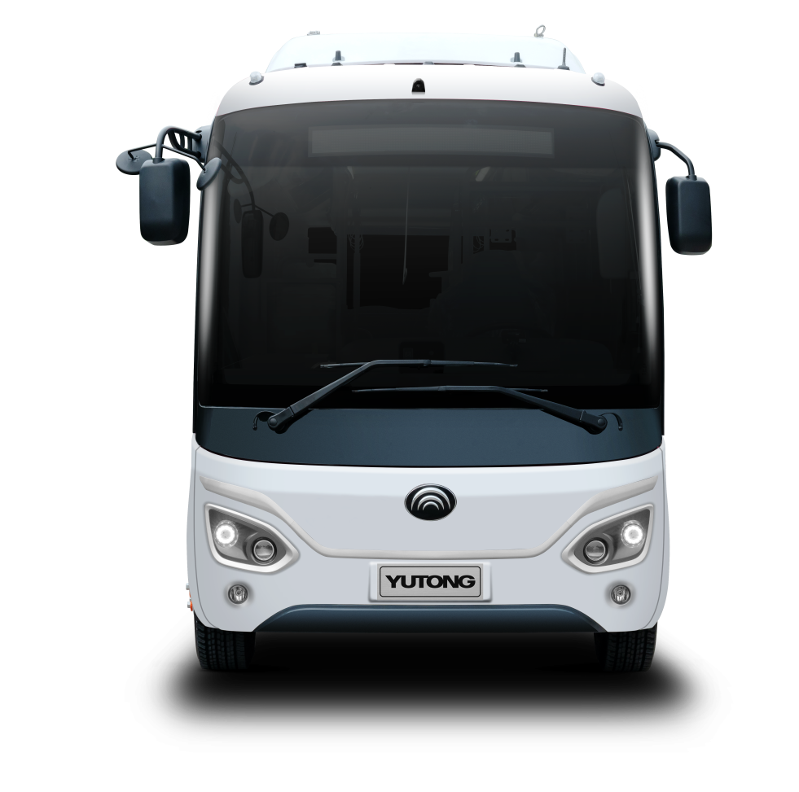
Elegant and Distinctive
High-tech Strength in Style
Front wall features the elegant split headlights with flying-wing chrome eyebrows; rear wall inherits the classic styling of micro-mobility bus; side wall has hidden column, suspended roof and integral fairing; the vehicle will undoubtedly become the business card of a city with its stylish design and approachable appearance.

Slide 6
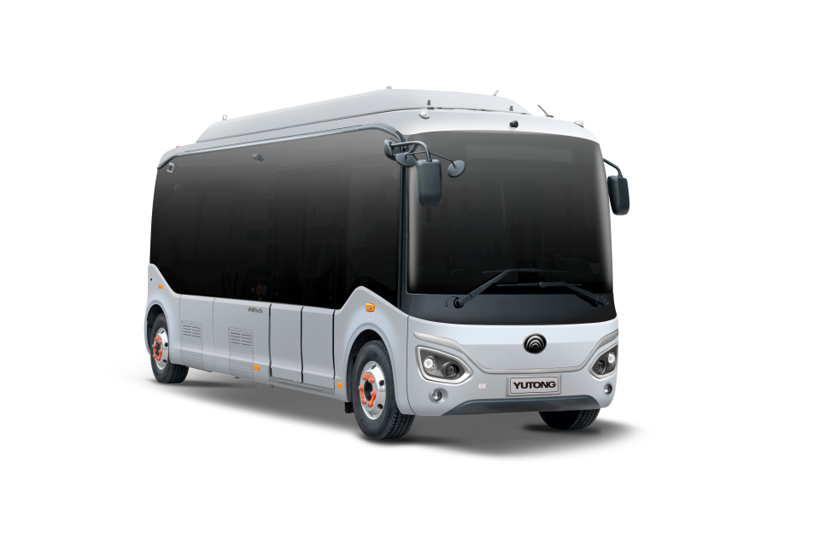
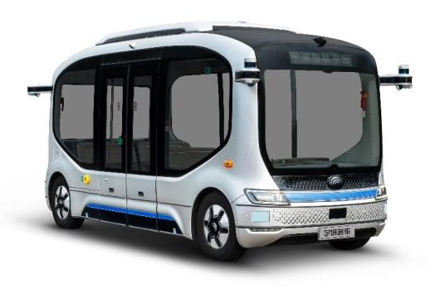
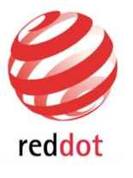
Elegant and Distinctive
Derived from the Red Award design
Based on the Xiaoyu2.0 design, its space capsule appearance is full of tech. "U-shaped" flying-wing decoration and smiling front face create a lovely and approachable bus which will become the business card of a city.
Excellent Appearance with Classic Design
Evolution

Slide 7
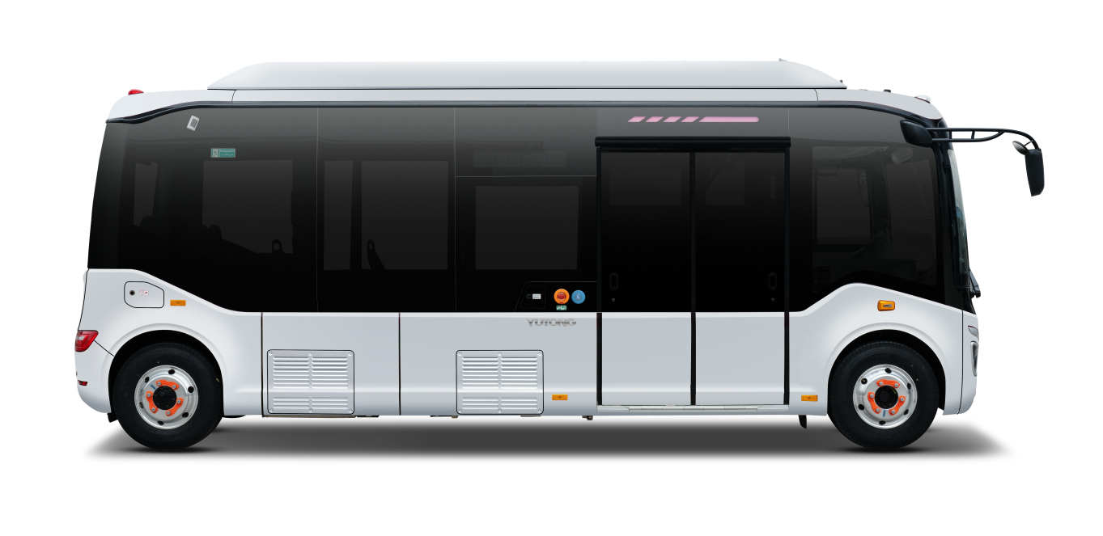
Elegant and Distinctive
Human Orientation to Show Strength
"Two shorts and one long": short front and short back overhangs plus super-long wheelbase create the largest flat floor in the industry. The flat-floor passenger area is as large as 3.8m2, fully demonstrating Yutong "customer-oriented" philosophy.
5250mm
6970mm

Slide 8
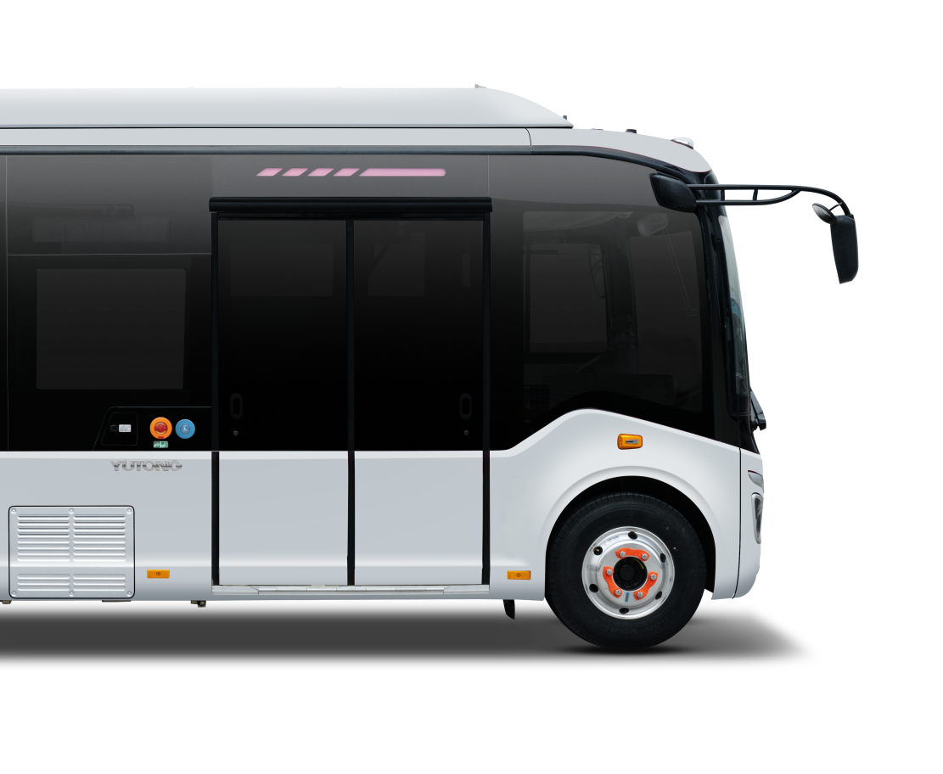
Elegant and Distinctive
Different Journey with New Experience
First-of-its-kind passenger door to bring 4 surprises to customers.
1. Narrow rubber inner seal makes it look better and unique.
2. Inner width of 1,200mm facilitates getting on and off at the same time, even when there is no emergency door in the left side wall;
3. Primary step of 340mm height makes boarding and alighting easy;
4. High reliability with no quality problem such as vibration, abnormal noise or stuck.
1200mm
340mm

Slide 9
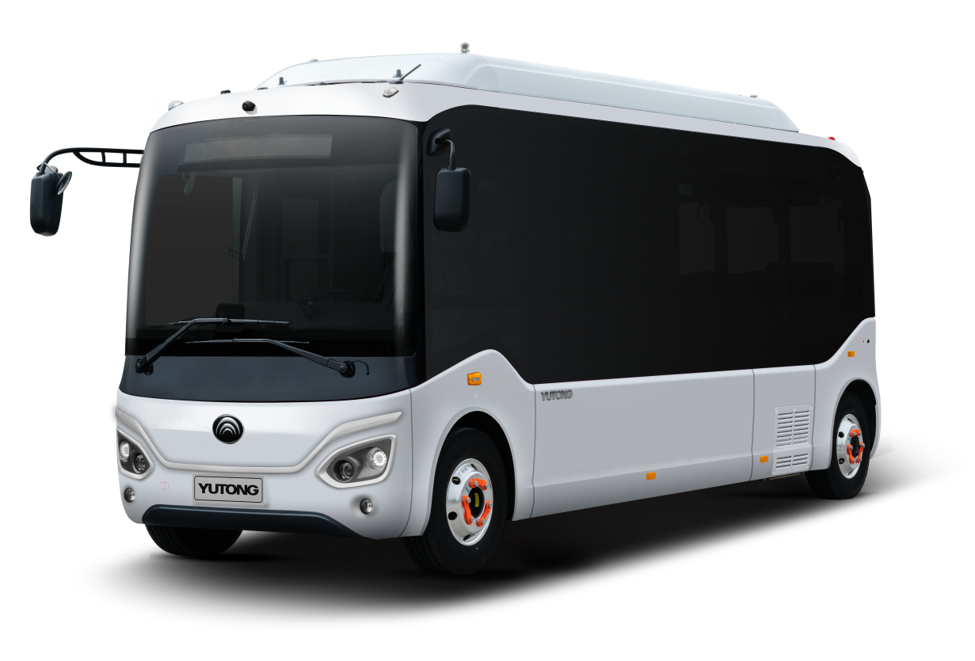
Elegant and Distinctive
Wide Vision
Happy Journey
High-transmittance windshield: front windshield is large with high light-transmittance, offering good field of vision for the driver; the side window pane height of 1200mm creates an excellent view in all directions.
1200mm

Slide 10
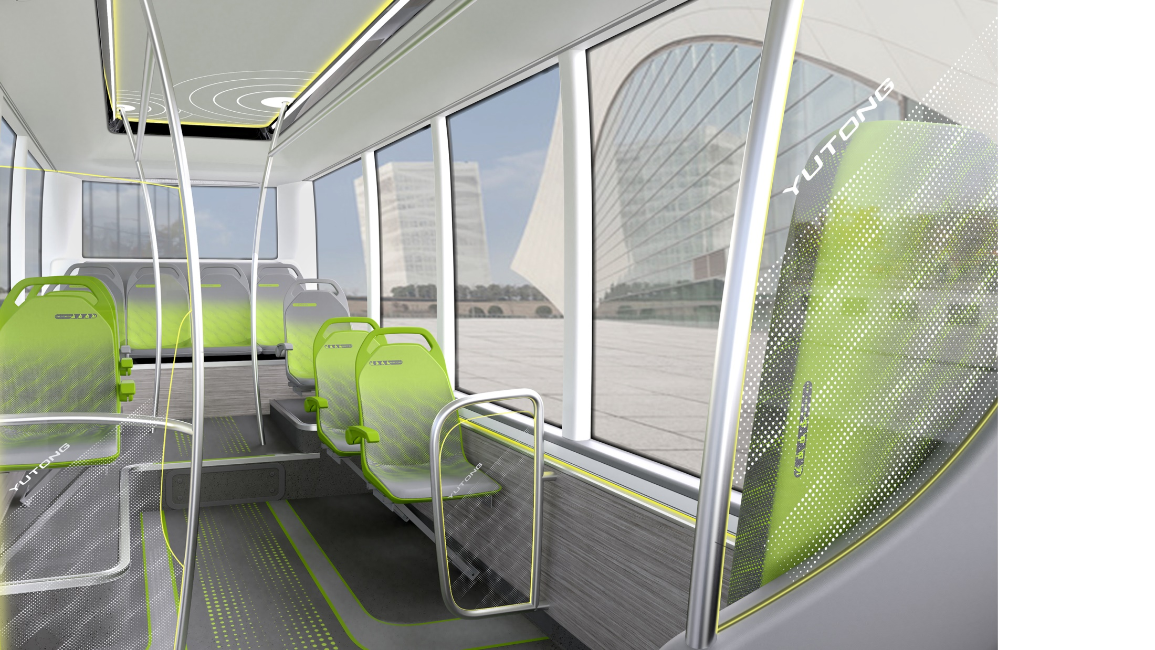
PART. 3
Interior
Light Luxury with
Comfort and Elegance

Slide 11
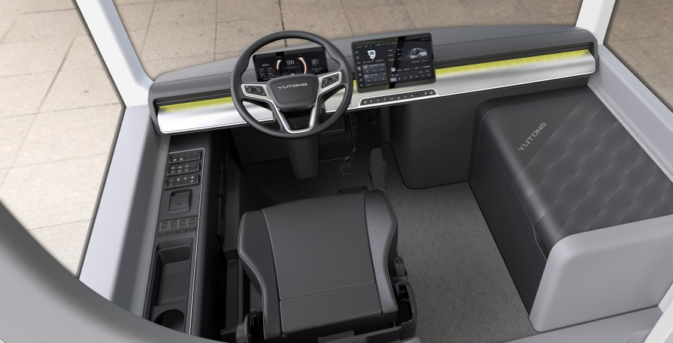
Light Luxury with Comfort and Elegance
Easy Control
● Brand new dashboard: Upgraded full LCD instrument looks simpler with comprehensive information display; optimized human-machine interaction with less buttons;
● Comfortable driving: The driving area floor is flat without steps, and spacious area brings more freedom for drivers. The steering system is optimized with a car-like steering wheel, and the new design of driver's seat comprehensively improves driving comfort;
● Storage space of the driving area: The instrument panel is user-friendly and easy to operate. There are multiple storage spaces on both sides to meet the driver's daily needs and improve the driving experience.

Slide 12
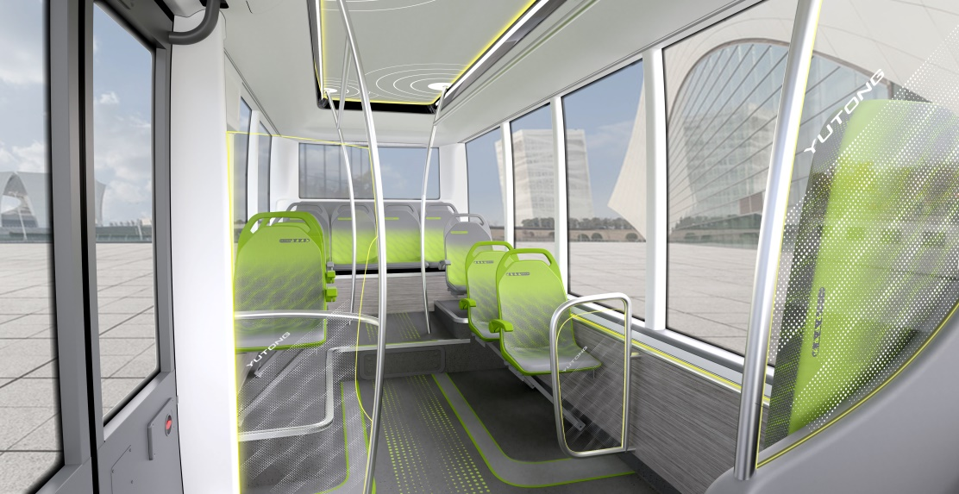
Light Luxury with Comfort and Elegance
Comfortable Riding Area
Aviation-style ceiling, additional ambient lights, hidden air ducts with large cross-section, hidden speakers and other facilities are available to create a luxurious atmosphere. Also there are air outlet diffusers, inclined seats, new armrests, and larger free space on board. Upgraded speakers and lighting equipment of high standards.

Slide 13
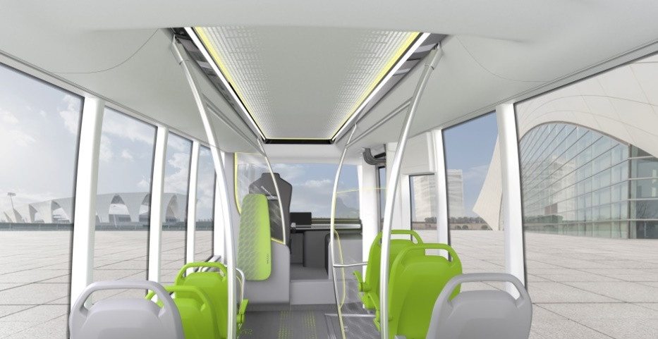
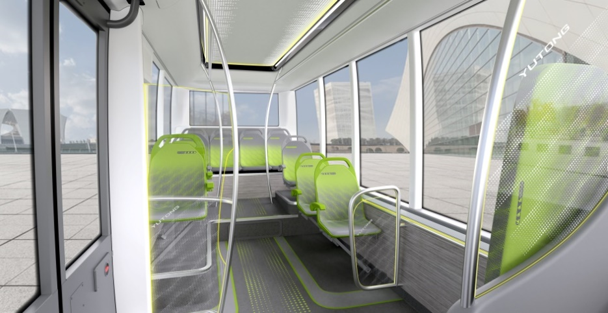
Light Luxury with Comfort and Elegance
● Fully enclosed dark-gray glass that integrates into the exterior, with a high-end style and double-layer thermal insulation to protect passengers.
● New armrest design and inclined seat convenient for passengers to hold and easy to clean and it feels more spacious on board.
● Long-wheelbase chassis for diversified seat layout, with obvious advantages in standing space. The side windows in high proportion bring comfortable riding and wide vision.

Slide 14
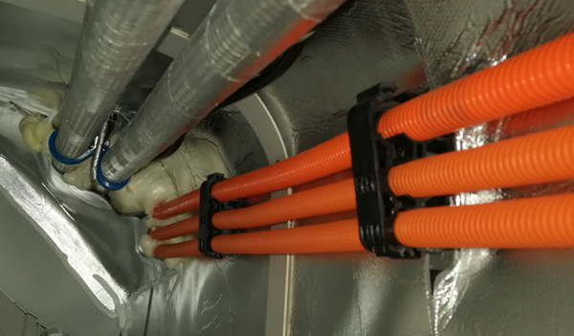
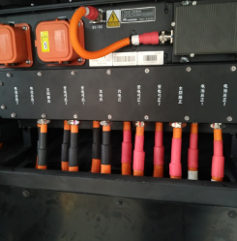
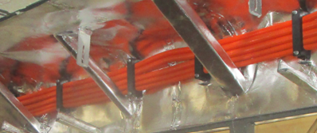
Light Luxury with Comfort and Elegance
New conduit line design
HV line and middle section conduit line are installed in a flat way, which improves the overall efficiency and fineness.

Slide 15
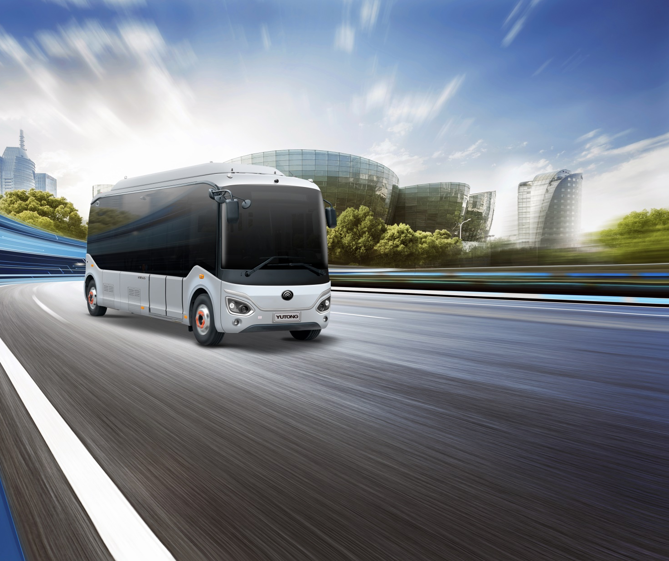
PART. 4
Features
Excellence in
Efficiency and Reliability

Slide 16
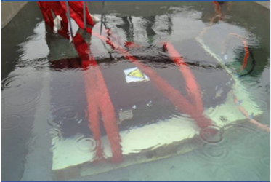
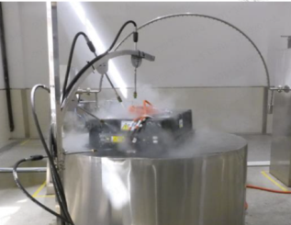
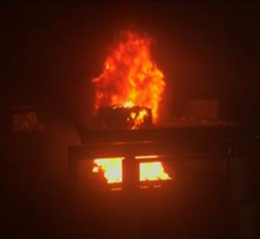
Great Technology for Super Safety
1. Standard liquid-cooling battery for safety
Real-time temperature monitoring effectively avoids high temperature to ensure battery safety;
Multiple tests eliminate risks. The battery passes the safety tests of puncture, squeezing, heating, high temperature, short circuit, immersion, etc. The battery is safe and reliable, which guarantees our client's operation and improves passengers' safety;
Special battery pack+sealed compartment effectively protect battery by avoiding the damage caused by water intrusion and flying gravels.
Definitions:
IPXX: the international standard of protection grade of electrical equipment against foreign objects, water and contact
IPX8: Grade 8 out of 0-8, which means qualification for the continuous immersion test, that is, the top of the box is 1.5-30 meters from the water surface for 30 minutes, and the performance is unaffected without leakage;
IPX9K: high-pressure spraying of 80℃ water for 30 seconds to the tested box at 0°, 30°, 60° and 90° angles in the shower test, without affecting the performance.
Immersion IPX8
High-pressure spray IPX9K
External burning

Slide 17
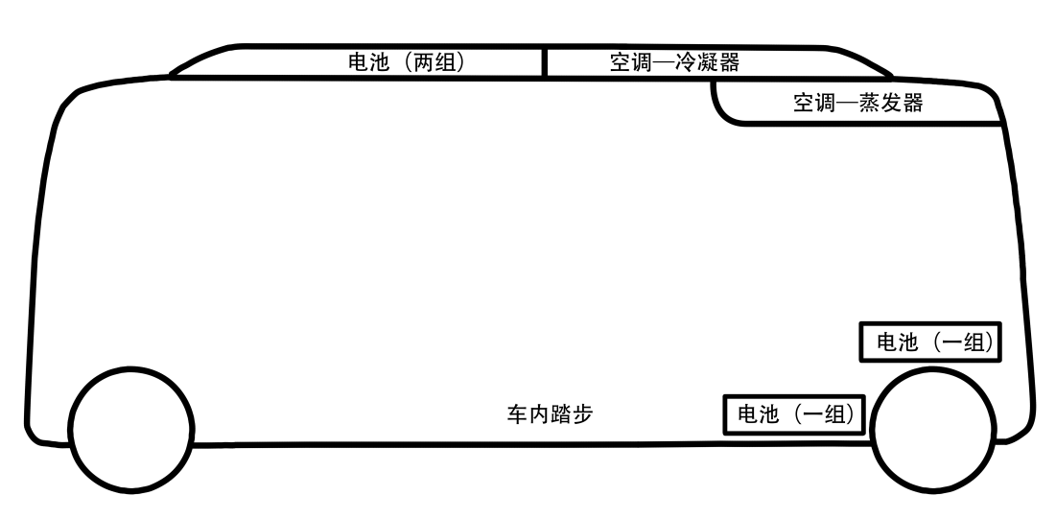
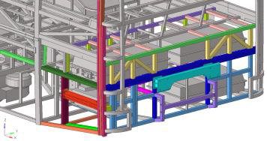
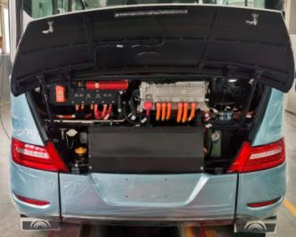
Great Technology for Super Safety
2. Top mounted battery for the safety of riders
Top + rear mounted battery
Avoid the impact to bottom-mounted battery,
and separate batteries from the passenger area;
Standard rear anti-collision device,
an effective protection of rear-mounted battery for the safety of passengers.
● Top mounted battery
● Rear mounted battery
● Anti-collision device

Slide 18
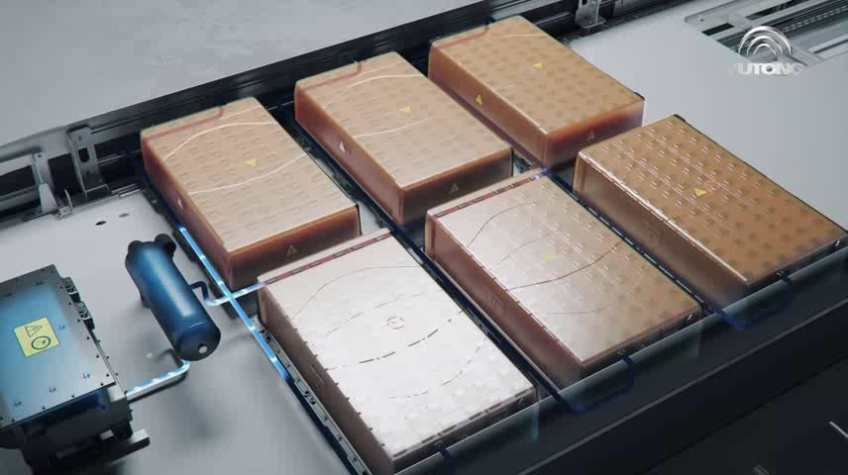
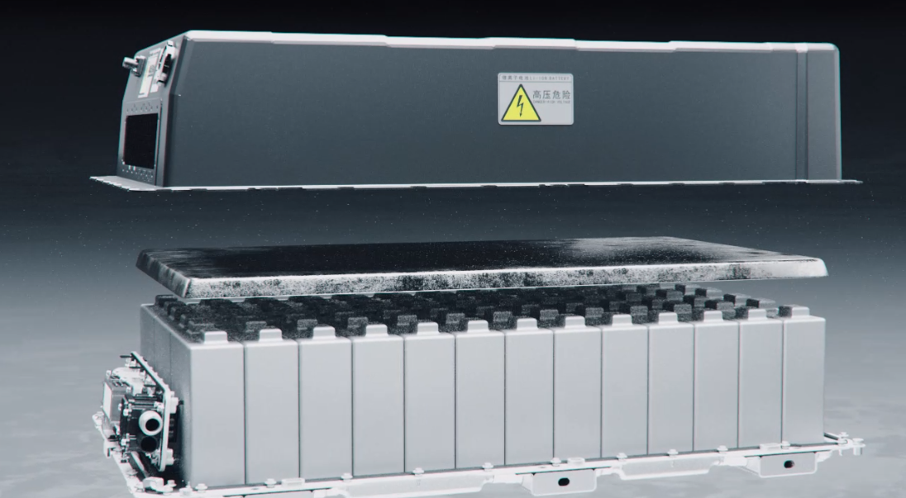
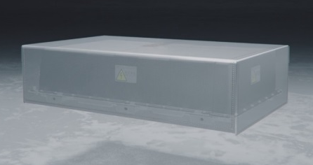
Great Technology for Super Safety
Internal heat-resistance and fire-proof layer
External anti-flame cover
3. Multiple protections for ease of mind
Nitrogen protection device features instant nitrogen production to create an enduring anaerobic environment for battery safety;
Multilayer thermal–electrical coupling protection effectively isolates internal and external potential safety hazards to improve battery safety.

Slide 19
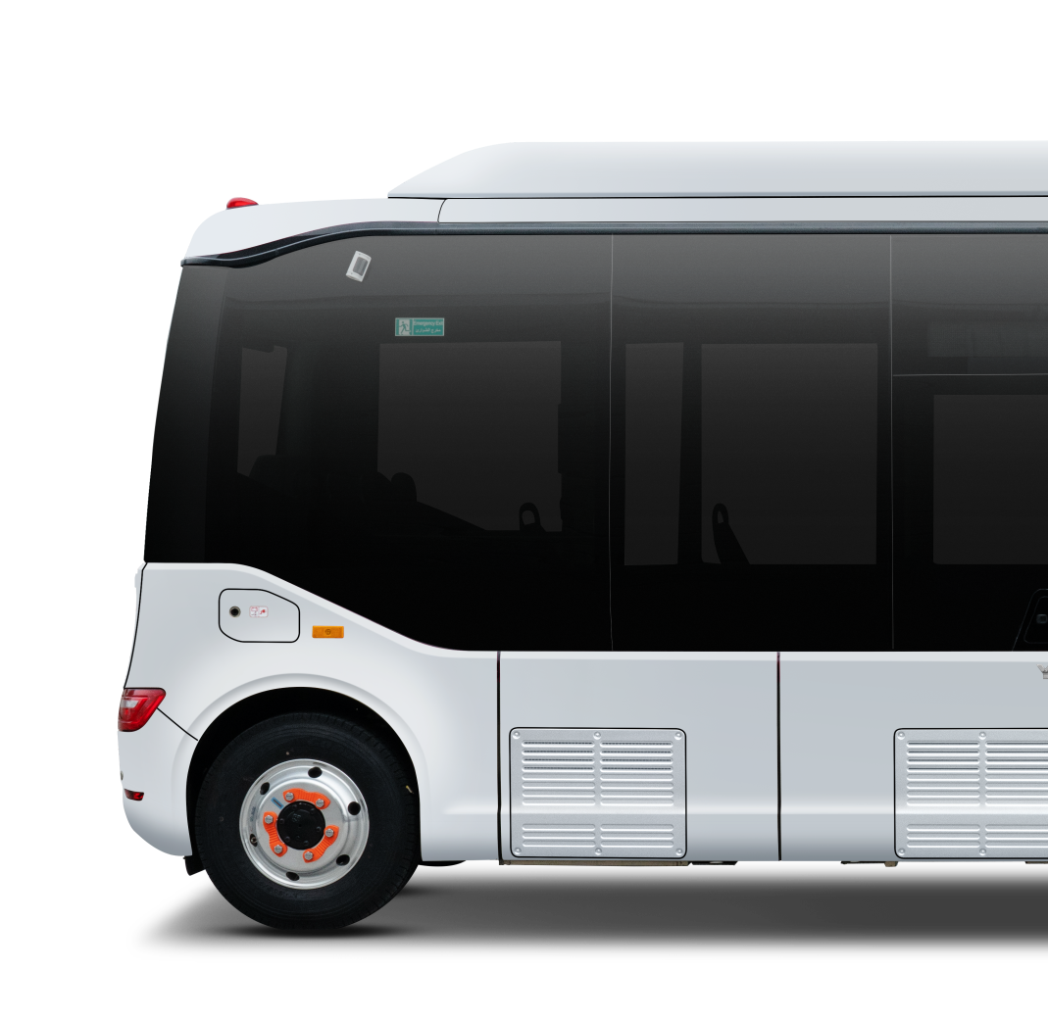
Human Orientation to Generate Super Adaptation
1. High ground clearance means high trafficability
The top-mounted battery and the body frame middle section with 200mm ground clearance generate adaptability to certain urban potholes, and reduce chassis impact to free you of trafficability concern.
200mm

Slide 20
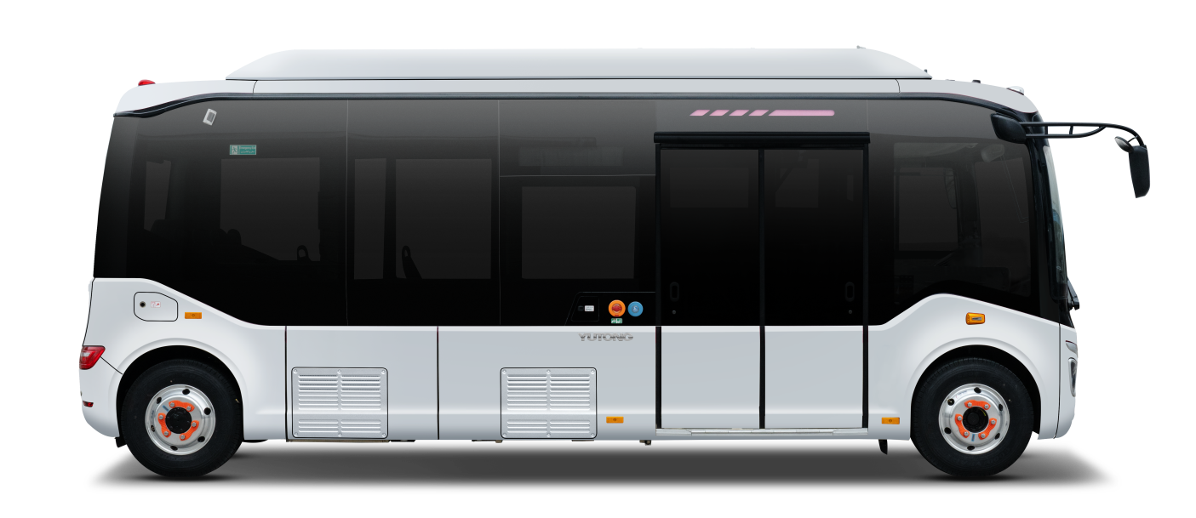
Human Orientation to Generate Super Adaptation
24°
21°
2. Large ground angles allow for greater adaptability
The approach angle of 21°, departure angle of 24° and the maximum gradeability of 16% effectively reduce the collision of front and rear bumpers, and increase adaptability to different routes.

Slide 21
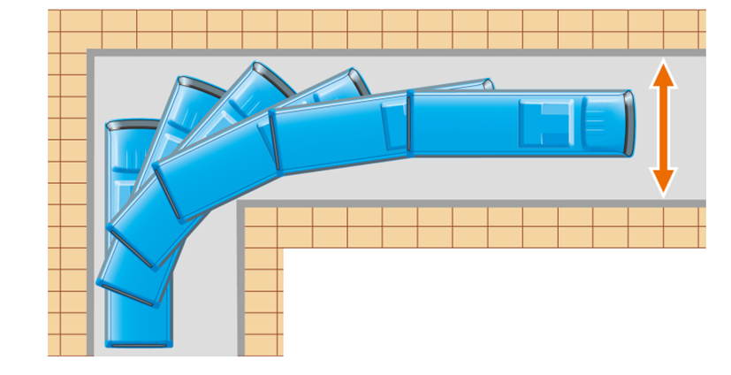
Human Orientation to Generate Super Adaptation
3. Small turning diameter ensures adaption to different road conditions
Long-wheelbase with a small turning diameter (wheelbase 5,250mm, width 2,100mm, turning diameter<17m) ensures adaptability to various road conditions.
Turning radius:
Left ＜ 8.3m
Right ＜ 8.4m

Slide 22

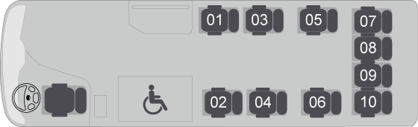
Strong Capability to Create More Comfort
1. Longest wheelbase among similar vehicles to create a large space
Short front and short back overhangs plus super-long wheelbase create the largest flat floor in the industry.
More effective space on board plus the wheelchair area and 10 seats allow for a maximum carrying capacity of 28 passengers, which leads the industry in terms of the passenger area space.

Slide 23

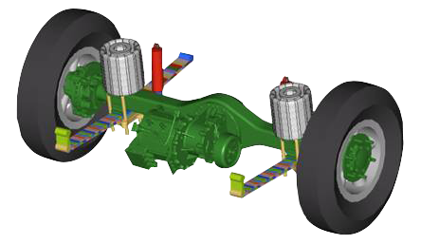
Strong Capability to Create More Comfort
2. Multi-functional composite suspension brings more comfort
The airbag composite suspension with reasonable layout leads to high space utilization; The suspension that creates riding comfort similar to that of air suspension is the first of its kind in the industry.

Slide 24
Strong Capability to Create More Comfort
3. The lowest step in the industry is convenient for the old and young
The first step at the entrance is 340mm high and the passenger door 1,200mm wide, generating more convenience for the elderly and children to get on board.
1200mm
340mm

Slide 25
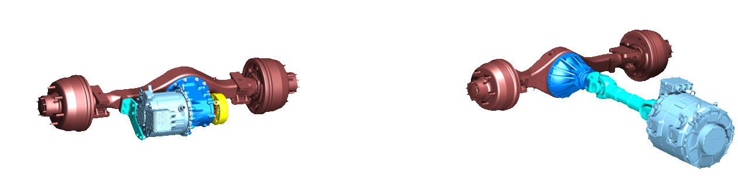
Intelligent Technology to Save Cost
Integrated e-drive axle is energy-saving, efficient and durable
The new integrated e-drive axle is 120kg lighter than the previous generation, increasing the vehicular economy;
The motor efficiency is 5% higher, and the energy consumption 3%–5% less. According to the SORT2 working condition test, the power consumption is only 0.37kWh/km, which is more energy-saving.
VS
Integrated external e-drive axle
Conventional direct drive powertrain

Slide 26
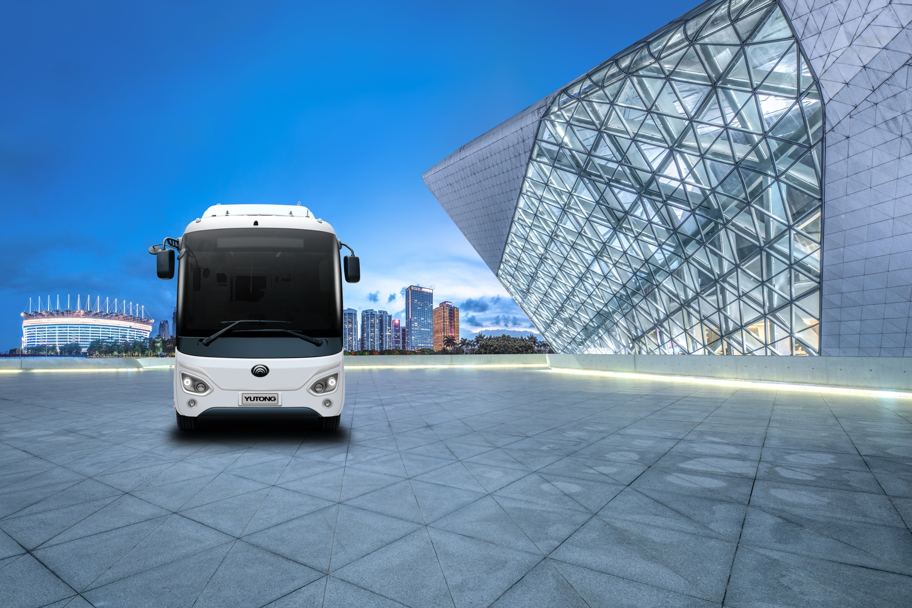
PART. 5
Specifications

Slide 27
Specifications
Items | Standard Configuration
L*W*H (mm) | 6970*2100*2890
Approach angle/Departure angle (°) | 21/24
Curb weight (kg) | 5700
Max. gross weight (kg) | 7700
Suspension system | Airbag composite suspension
Rated capacity (driver and passengers included) | 28/11
Drive motor power (kW) | 65/120
Maximum speed (km/h) | 69
Maximum gradeability | 16%
Battery energy (kWh) | 163.36
Electricity consumption (kWh/km, SORT2) | 0.37
Driving range (km, constant speed) | 385
Axle | Rigid front axle/integrated e-drive rear axle
Brakes | Front/rear disc
Repairing/maintenance | One-piece front flap cover
Traction motor | Rated power of 65, rated torque of 170
Passenger door | Double-leaf in-swing door with an opening of 1.2m; Height of passenger door first step: 340mm
Window | Dark gray fully-enclosed double-layer glass
A/C | CLING electric overhead cooling A/C (cooling capacity 20,000kcal/h, HIGHLY compressor)
        Note: The configuration may vary and the actual vehicle configuration prevail.

